Slide 1
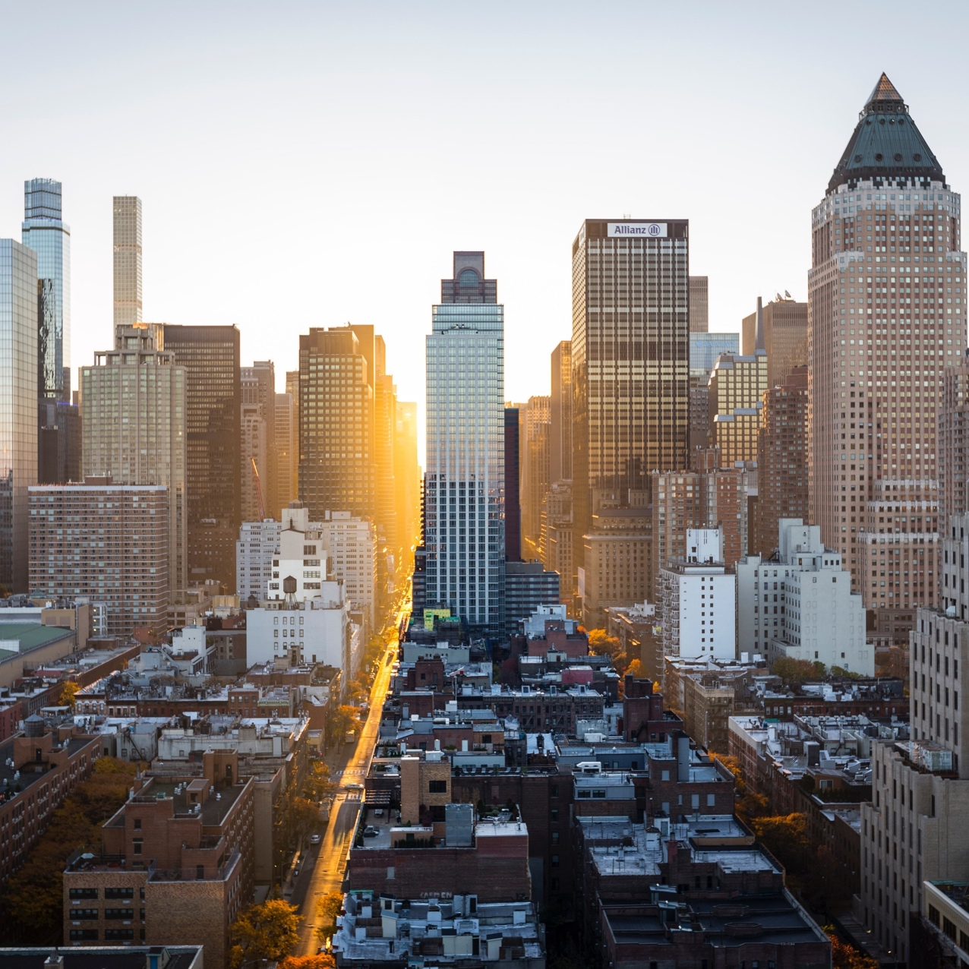
Presentation smart city
Subtitle-: A Comprehensive Smart City Solution

Slide 2
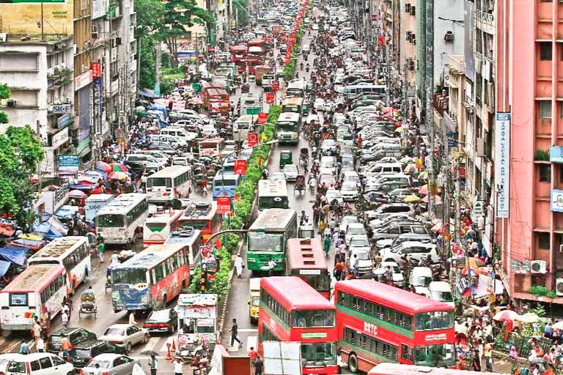
The Challenges of Urbanization
Increasing population and urbanization, Traffic congestion and air pollution
inefficient energy consumption and waste management
Limited public services and amenities

Slide 3
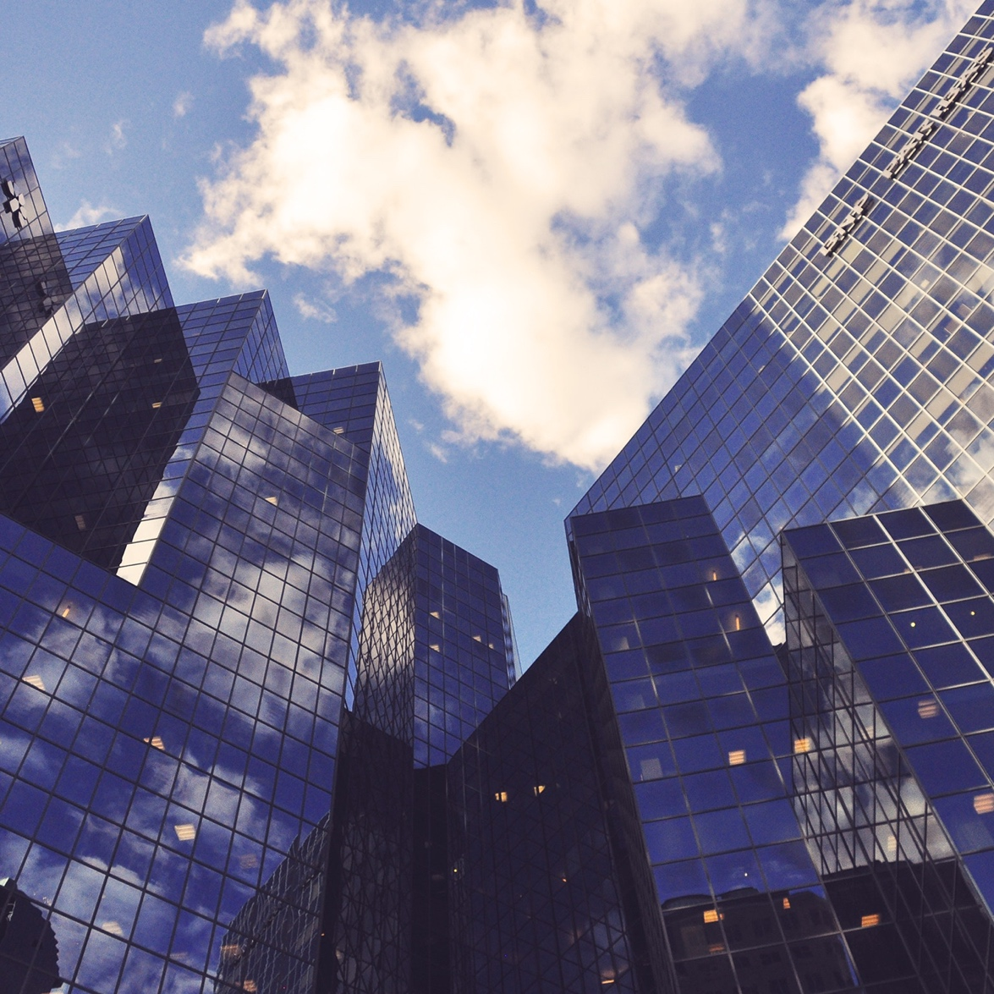
"Smart City - A Comprehensive Smart City Solution"
Integrated traffic management system
Smart energy grid and efficient energy consumption
Intelligent waste management and recycling system
Enhanced public services and amenities

Slide 4
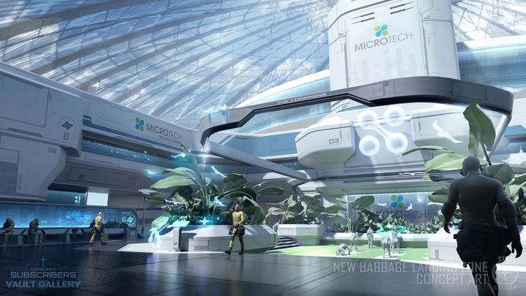
"Unlocking the Power of Smart City"
Improved quality of life for citizens
Increased efficiency and productivity for businesses
Enhanced public safety and security
Better environmental sustainability and reduced carbon footprint

Slide 5
Chart

Slide 6
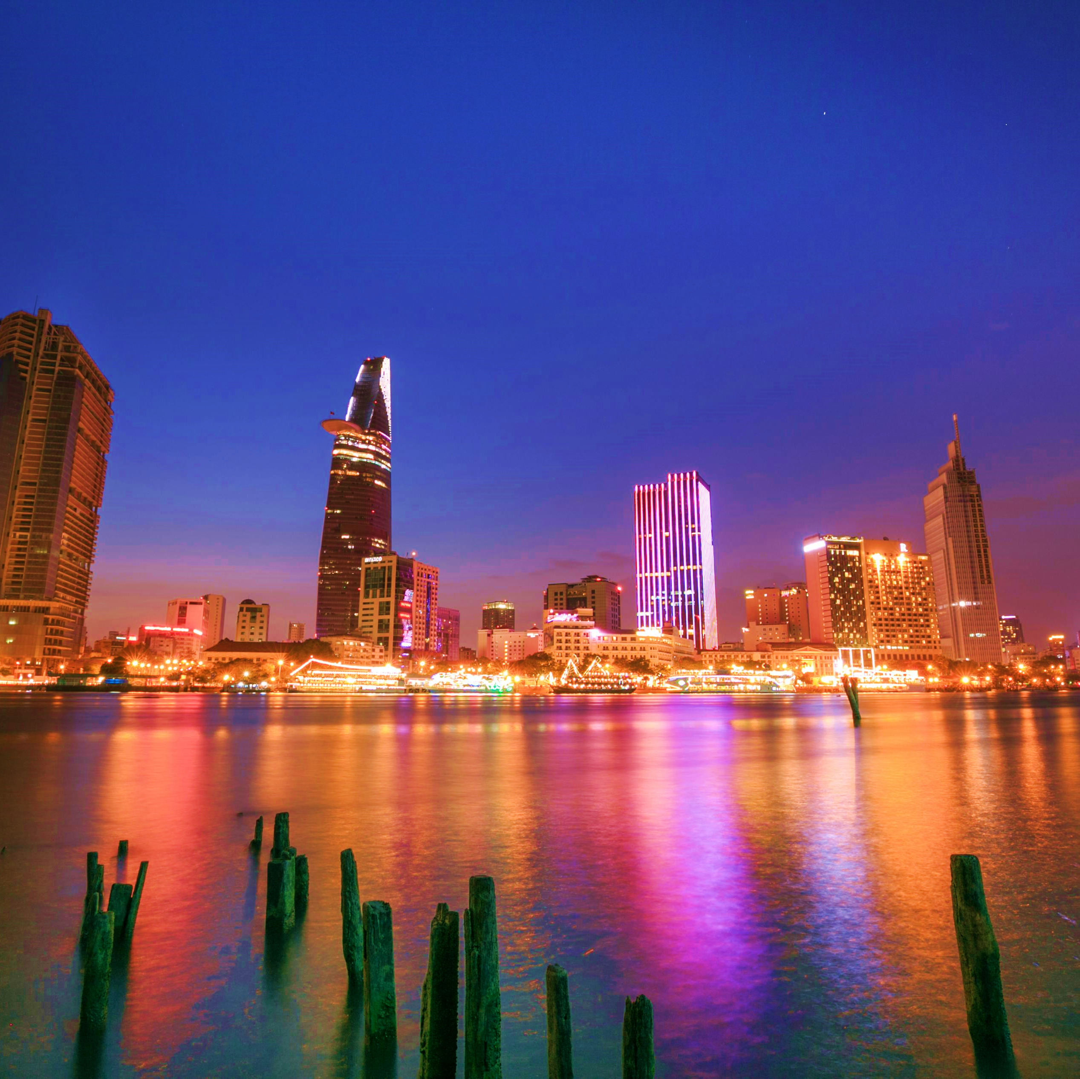
"Join the Smart City Revolution"
Partner with us to develop a smart city
Learn more about Smart City's features and benefits
Contact us for a demo or trial

Slide 7


QUIZ

Slide 8

Thank you !
atiyab151@gmail.com

